Slide 1
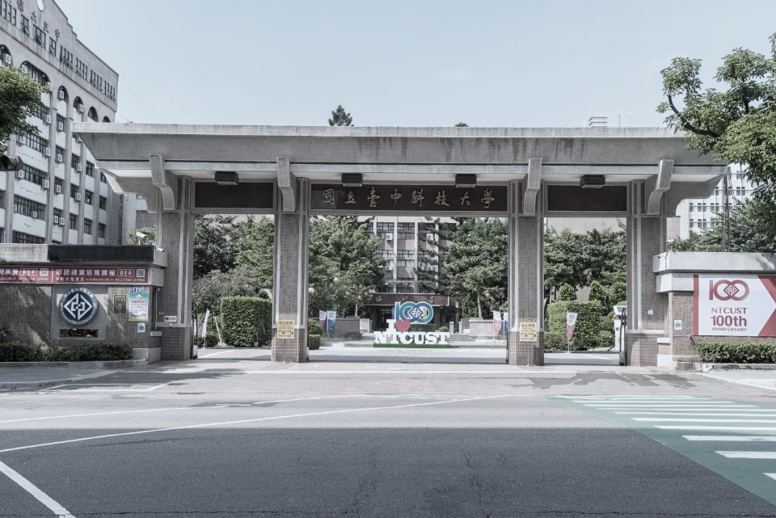
Stock Prediction Based on Deep Neural Network Combining Mixed Frequency Financial Data and Monthly Revenue
碩士學位考試
口試學生 : 林毓翔
口試委員 : 國立中興大學 劉宗榮教授
國立中山大學 楊惠芳教授
國立臺中科技大學 劉冠顯教授
日期 : 2024年12月13日 16:00
地點 : 弘業樓4樓6402室

Slide 2
Outline
Introduction
Related Work
Method
Datasets
Experiments
Conclusion
Future Work
References

Slide 3
Introduction

Slide 4
Introduction(1/6)
What is Stock prediction?
Stock prediction is forecasting future stock prices based on historical data.
Stock prediction
a popular topic within financial research
attracting diverse methodologies
Various methods
forecast stock price trends
devise effective trading strategies

Slide 5
Introduction(2/6)
Ball et al [1]
Found that there is a correlation between stock price and accounting information.
Investors can obtain excess profits from company stocks achieving high prediction accuracy.
Zhang et al. [2]
Study the relationship between China's listed stocks and five financial and trading factors (revenue, net profit, financial surplus, financial surplus, trading volume)
In the electronic information industry, the correlation between stock price and revenue or net profit is relatively high.

Slide 6
Introduction(3/6)
Doshi et al.[3]
Long Short-Term Memory (LSTM) for stock prediction
achieving high prediction accuracy with minimal errors.
Kryzanowski et al.[4]
Neural networks combining financial ratios and macroeconomic factors
Achieve an accuracy of 72% in classifying the positive and negative returns of stock prices within a year.
Notes:
Kryzanowski等人[15]研究顯示神經網路結合財務比率與宏觀經濟因子可以達到準確率72%分類一年內股價的正負報酬。

Slide 7
Introduction(4/6)
Das et al. [5]
Transforemer model to predict the stock prices of IBM, APPLE and TATAMOTORS.
Achieve smaller prediction errors.
Lin et al.[6]
Used the WGAN-GP model to predict the Nasdaq Composite Index (NASDAQ) , New York Stock Exchange Composite Index (NYSE)…
The prediction effect is better than that of LSTM, GRU and GAN models.

Slide 8
Introduction(5/6)
Aadhitya et al. [7]
CNN_LSTM Neural Network mode for stock prediction
Achieving great performance
WANG et al. [8]
Proposed Transformer-TCN model for stock prediction
Better prediction results than other hybrid models in Shanghai and Shenzhen stock markets.

Slide 9
Introduction(6/6)
We proposed a improved framework based on the Transformer model.
Attention mechanism for boosting performance
The proposed framework is validated on various dataset,specifically in our cross-frequency dataset.
A cross-frequency dataset quarterly financial ratios and monthly revenue data

Slide 10
Related Work

Slide 11
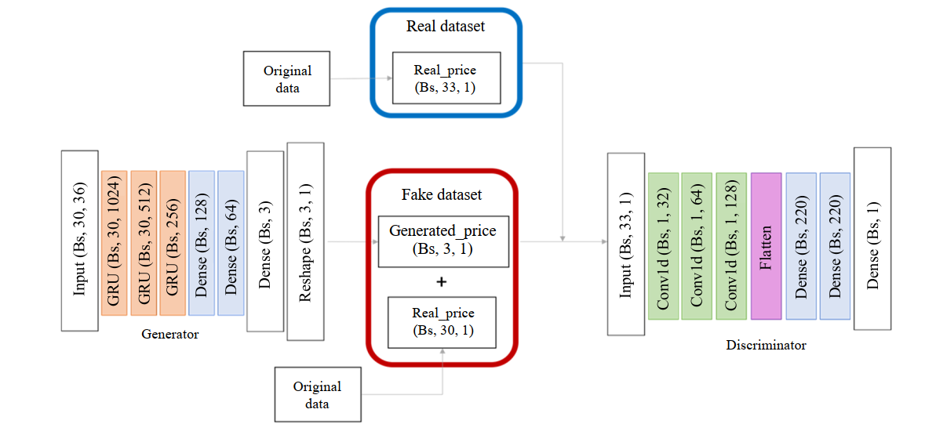
Related Work(1/6)
Stock price prediction using Generative Adversarial Networks [6]

Slide 12
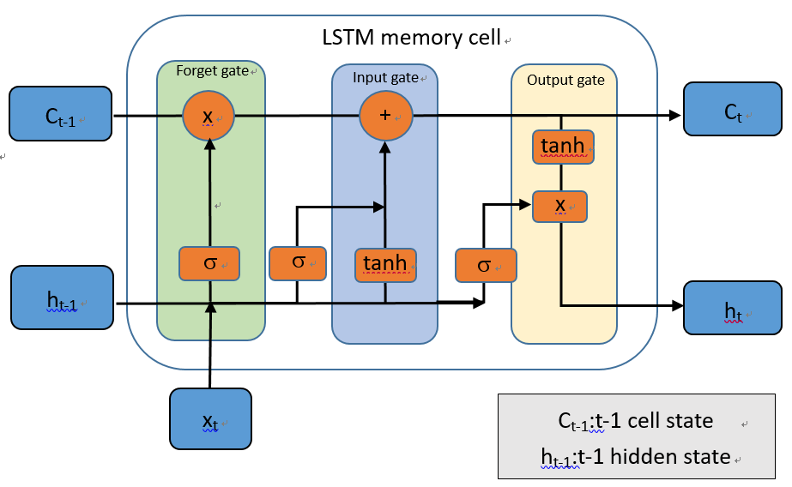
Related Work(2/6)
Predicting Stock Market time-series data using CNN-LSTM Neural Network model[7]

Slide 13
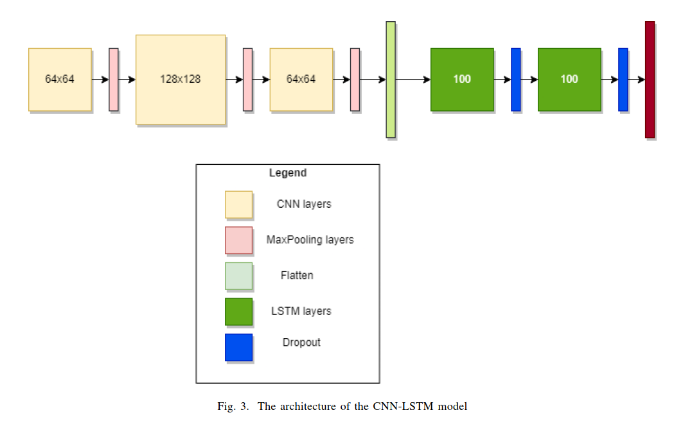
Related Work(3/6)
Predicting Stock Market time-series data using CNN-LSTM Neural Network model[7]

Slide 14
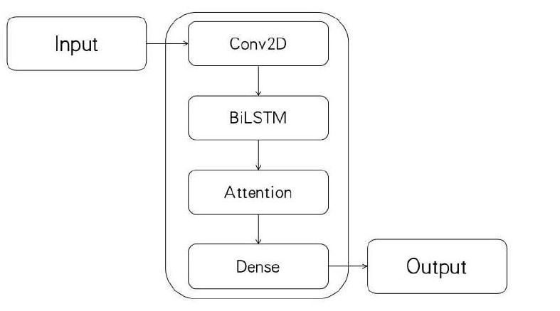
Related Work(4/6)
Stock Price Prediction Using CNN-BiLSTM-Attention Model[9]

Slide 15
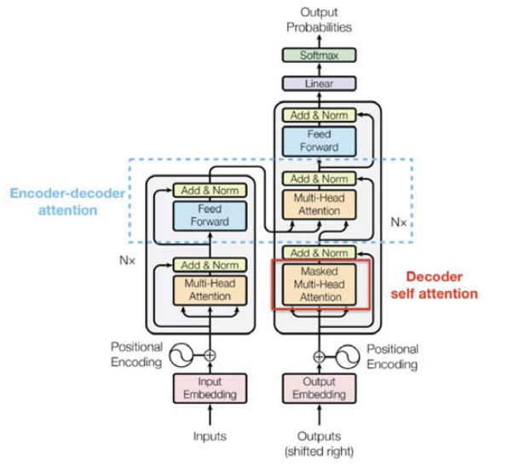
Related Work(5/6)
Stock_Price_Prediction_Using_Time_Embedding_and_Attention_Mechanism_in_Transformers[5]

Slide 16
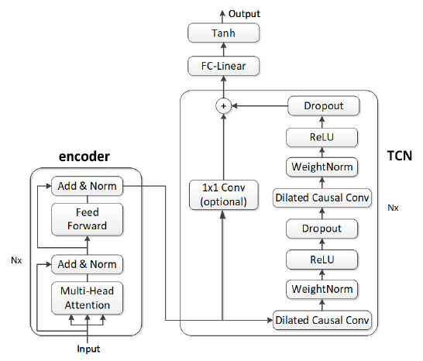
Related Work(6/6)
A_Stock_Price_Prediction_Method_Based_on_BiLSTM_and_Improved_Transformer[8]

Slide 17
Method

Slide 18
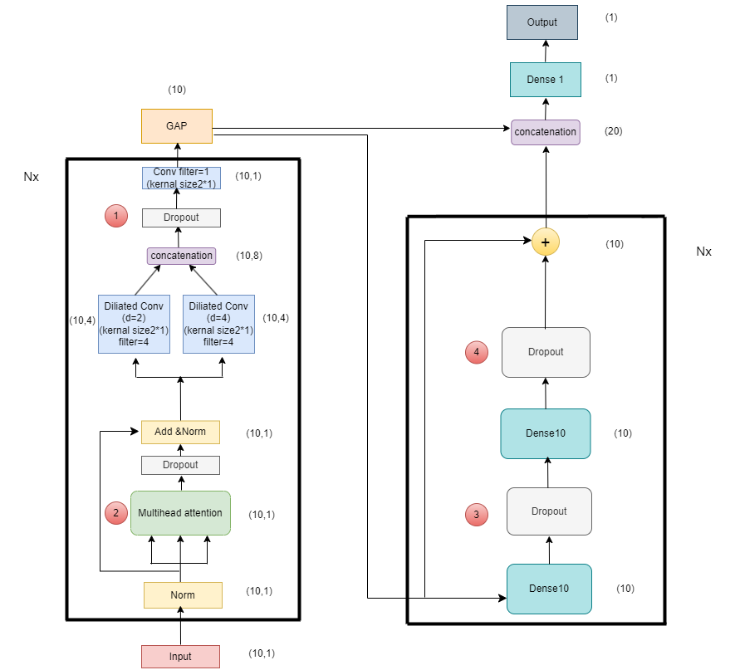
Method(1/13)
The overall architecture of proposed model
for AAPL, TSLA, MSFT, IBM

Slide 19
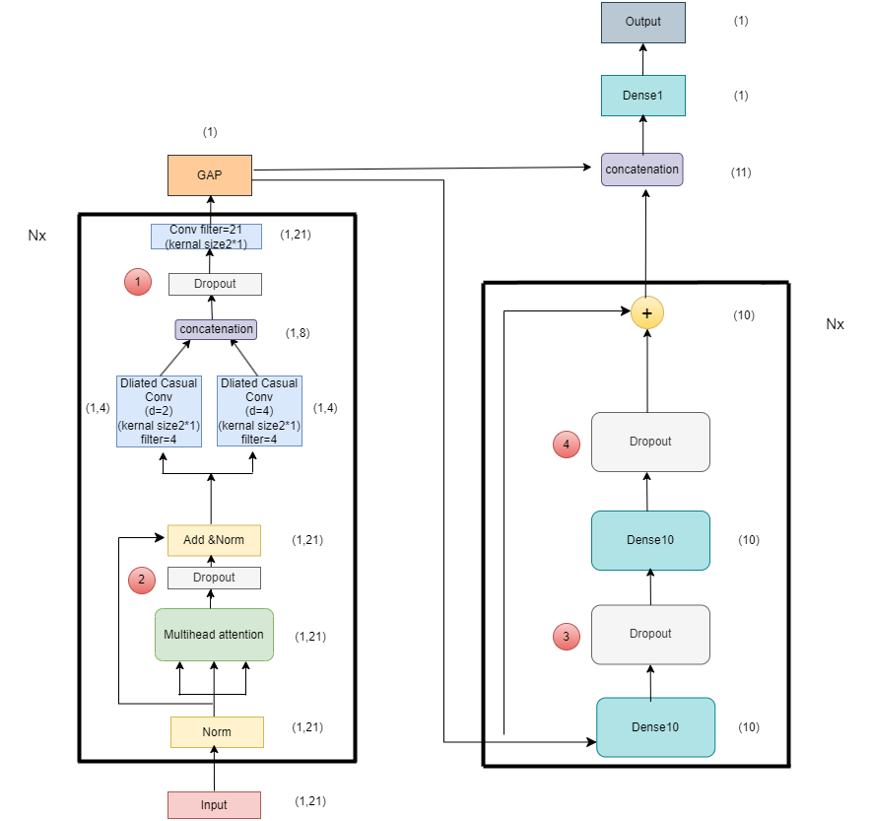
Method(2/13)
The overall architecture of proposed model
for StockQM

Slide 20
Method(3/13)
The overall architecture of proposed model
月份 | 季財務資料 | 月財務資料 | 預測股價 | 符號表示
5 | 5/15前公布第一季財報(1~3月) | 6/10公布5月營收 | 6/30股價 | T
6 | 5/15前公布第一季財報(1~3月) | 7/10公布6月營收 | 7/31股價 | T-1
7 | 5/15前公布第一季財報(1~3月) | 8/10公布7月營收 | 8/31股價 | T-2
8 | 8/14前公布第二季財報(4~6月) | 9/10公布8月營收 | 9/30股價 | T
9 | 8/14前公布第二季財報(4~6月) | 10/10公布9月營收 | 10/31股價 | T-1
10 | 8/14前公布第二季財報(4~6月) | 11/10公布10月營收 | 11/30股價 | T-2
11 | 11/14前公布第三季財報(7~9月) | 12/10公布11月營收 | 12/31股價 | T
12 | 11/14前公布第三季財報(7~9月) | 1/10公布12月營收 | 1/31股價 | T-1
1 | 11/14前公布第三季財報(7~9月) | 2/10公布1月營收 | 2/28股價 | T-2
2 | 11/14前公布第三季財報(7~9月) | 3/10公布2月營收 | 3/31股價 | T-3
3 | 3/31前公布第四季財報(10~12月) | 4/10公布3月營收 | 4/30股價 | T
4 | 3/31前公布第四季財報(10~12月) | 5/10公布4月營收 | 5/31股價 | T-1

Slide 21
Method(4/13)
Model parameter
Dataset | Total params | Flops | Training Time
AAPL | 4889 | 20625 | 15min
TSLA | 7055 | 17389 | 16min
MSFT | 6333 | 3934 | 17min
IBM | 8437 | 9172 | 12min
StockQM | 59932 | 135057 | 15min

Slide 22
Method(5/13)
18 quarterly Financial indicators(Solvency)
Debt ratio
Long term debt to total assets ratio
Current ratio
Quick ratio
Interest coverage ratio

Slide 23
Method(6/13)
18 quarterly Financial indicators(Operational ability)
Accounts receivable turnover ratio
Average collection days
Inventory turnover
Days sales of inventory
Asset turnover ratio

Slide 24
Method(7/13)
18 quarterly Financial indicators(Profitability)
Gross profit margin
Operating profit margin
Net income margin
Return on assets
Return on equity

Slide 25
Method(8/13)
18 quarterly Financial indicators(Cash flow)
Operating cash to current liabilities ratio
Operating cash to liabilities ratio
Operating cash to net earnings after tax ratio

Slide 26
Method(9/13)
3 monthly Financial indicators
Month on month
Year On year
Quarter on quarter

Slide 27
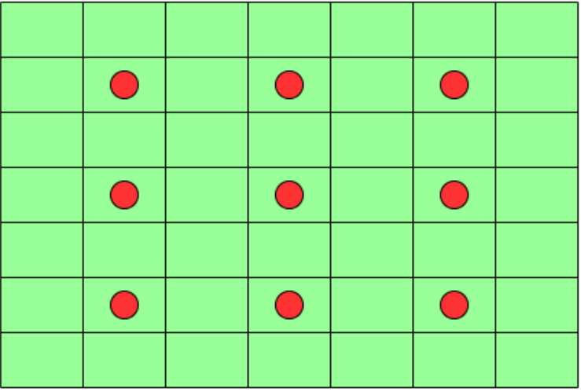
Method(10/13)
Dilation CONV1D

Slide 28
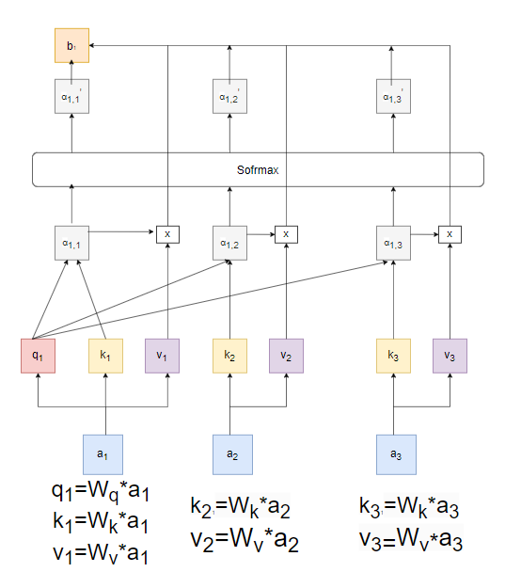

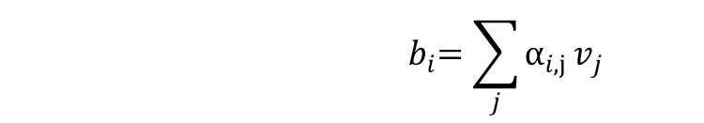
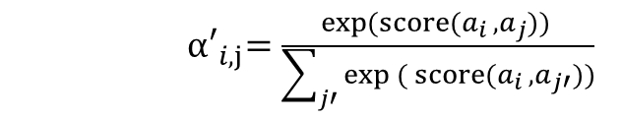
Method(11/13)
Self Attention(1)
score($a_{i}$ , $a_{j}$) = tanh($W_{q}a_{i}$ + $W_{k}a_{j}$)
${ α′}_{i,j}=\frac{\exp{(score(a_{i} , a_{j})}) }{\sum_{j′}{\exp{({score(a_{i} , a_{j′})}})}}$
$${ b}_{i}=\sum_{j}{α_{i,j}}v_{j}$$

Slide 29
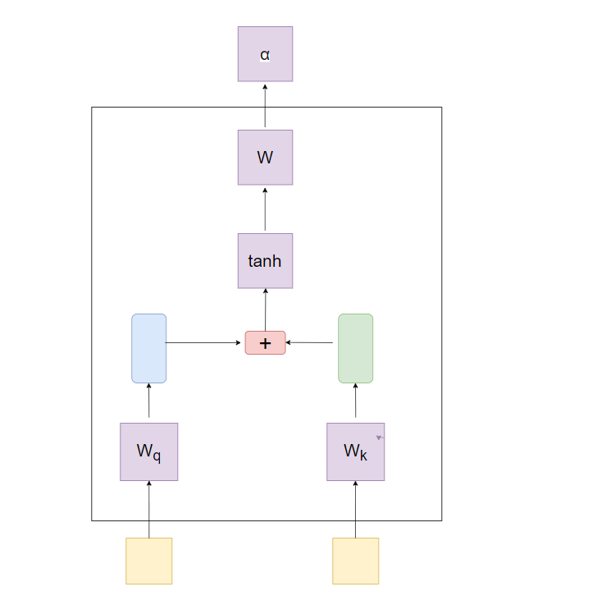
Related Work(12/13)
Self Attention(2)

Slide 30
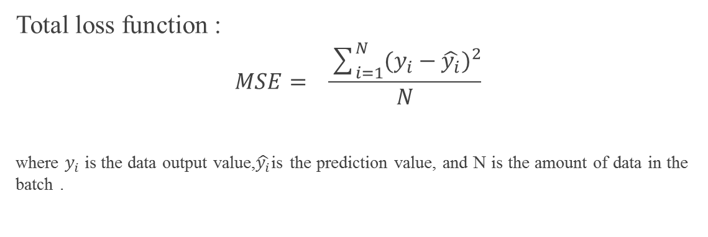
Method(13/13)
Total loss function :
$$MSE= \frac{\sum_{i=1}^{N}{(y_{i}−{\hat{y_{i}})}^{2}}}{N}$$
where $y_{i}$is the data output value,$\hat{y_{i}}$is the prediction value, and N is the amount of data in the batch .

Slide 31
Datasets

Slide 32
Datasets(1/3)
stock
data period
Four company stock
Select daily stock prices of TSLA, MSFT, IBM, and APPL in Yahoo Finance
AAPL data period is 1980/12/12~2024/7/31, Select 6598 data as training data and 2200 data as validation data and 2200 data as test data.
TSLA data period is 2010/6/29~2024/7/31, Select 2127 data as training data and 709 data as validation data and 709 data as test data.

Slide 33
Datasets(2/3)
stock
data period
Four company stock
MSFT data period is 1986/3/13~2024/7/31, Select 5803 data as training data and 1934 data as validation data and 1934 data as test data.
IBM data period is 1980/1/1~2024/7/31, Select 6742 data as training data and 2248 data as validation data and 2248 data as test data.

Slide 34
Datasets(3/3)
stock
StockQM
Includes 18 quarterly financial indicators and 3 monthly revenue indicators which are provided by the Public Information Observatory.
405 companies spans 44 quarter total 132 months months from May 2013 to May 2024, with incomplete data points removed.
The target variable, representing the stock price at the end of the next month after the stock quarterly earnings report is released.
32,076 data for training and 10,692 data for validation,10,692 for testing.

Slide 35
Experiments

Slide 36
Experiments(1/43)
Implementation environment :
CPU：Intel Xeon 2800G
GPU：NVIDIA GeForce RTX 2080 Ti
RAM：128GB
Development Framework：Tensorflow、Keras
Programming Language：Python3.7

Slide 37
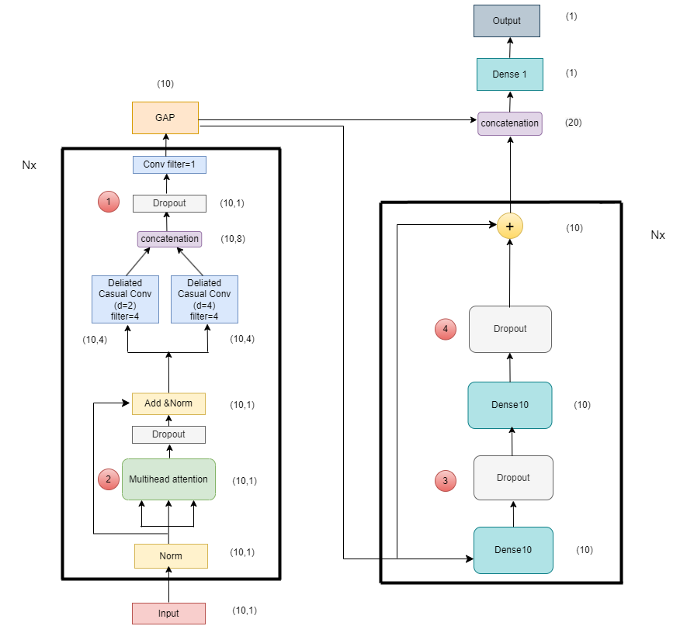
Experiments(2/43)
Ablation study of mymodel on AAPL, TSLA, MSFT, IBM

Slide 38
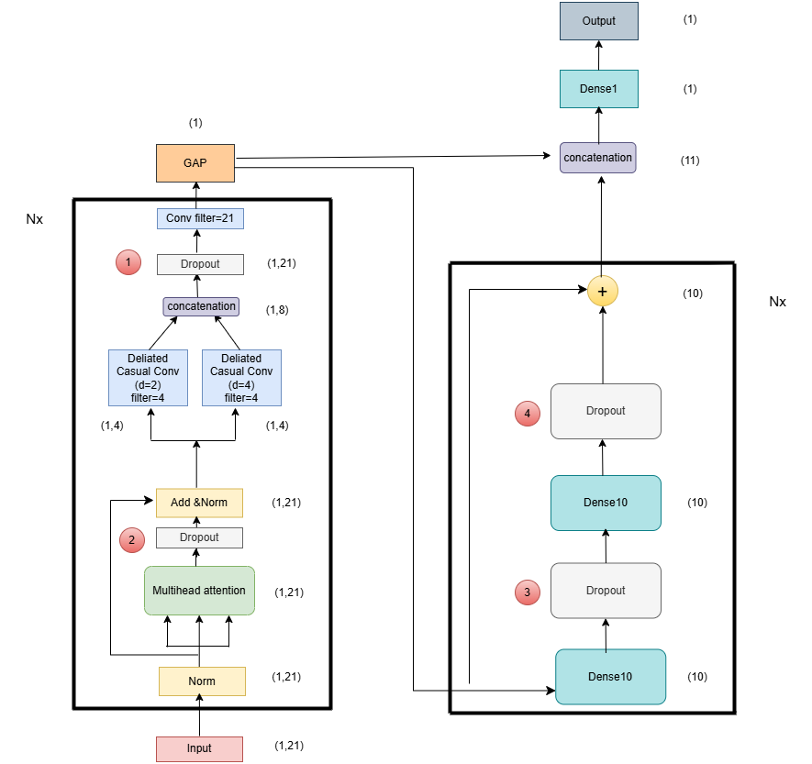
Experiments(3/43)
Ablation study of mymodel on mydata

Slide 39
Experiments(4/43)
Compare the impact of dropout ratios
MAE
Dataset | dropout10% | dropout 15% | dropout 20% | dropout 25% | dropout 30% | No dropout
AAPL | 15.52 | 22.09 | 28.93 | 14.74 | 49.82 | 30.01
TSLA | 186.79 | 242.69 | 98.32 | 35.38 | 105.37 | 419.98
MSFT | 43.25 | 69.96 | 11.67 | 7.46 | 12.82 | 123.57
IBM | 4.08 | 2.76 | 3.89 | 2.51 | 2.83 | 34.52
StockQM | 32.33 | 43.54 | 29.37 | 31.74 | 33.19 | 38.07

Slide 40
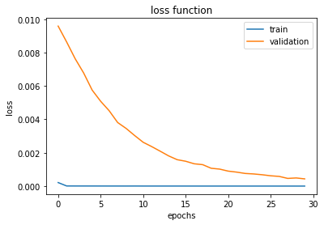
Experiments(5/43)
AAPL dropout 25% loss function

Slide 41
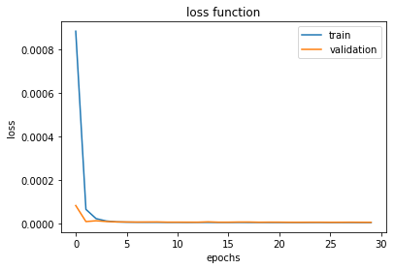
Experiments(6/43)
MSFT dropout 25% loss function

Slide 42
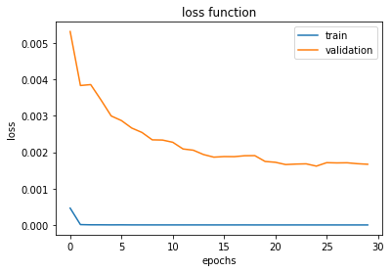
Experiments(7/43)
TSLA dropout 25% loss function

Slide 43
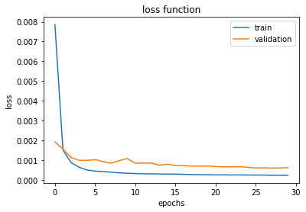
Experiments(8/43)
IBM dropout 25% loss function

Slide 44
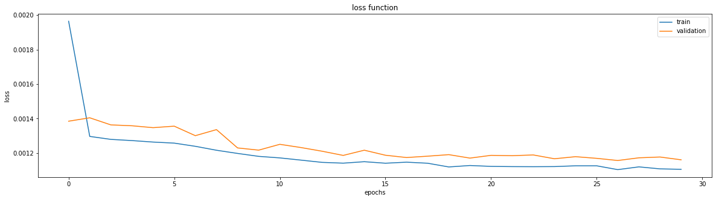
Experiments(9/43)
StockQM dropout 25% loss function

Slide 45
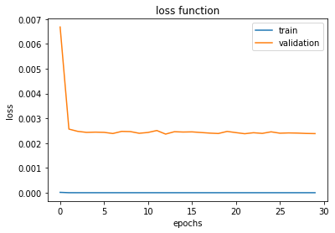
Experiments(10/43)
AAPL nodropout loss function

Slide 46
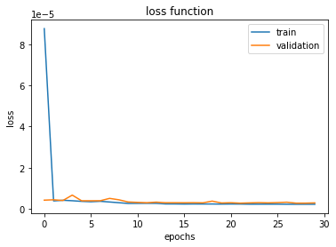
Experiments(11/43)
MSFT nodropout loss function

Slide 47
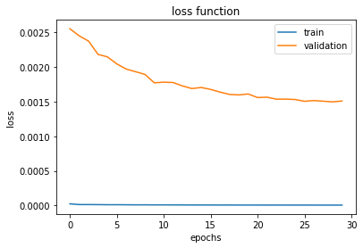
Experiments(12/43)
TSLA nodropout loss function

Slide 48
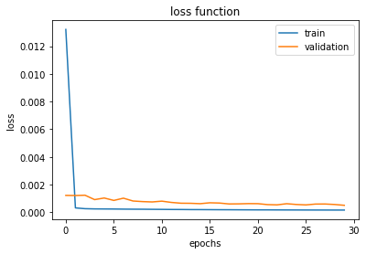
Experiments(13/43)
IBM nodropout loss function

Slide 49
Experiments(14/43)
StockQM nodropout loss function

Slide 50
Experiments(16/43)
Comparing the impact of dropping out of school
資 料 集 | MAE
 | dropout1個(1) | dropout1個(2) | dropout1個(3) | dropout1個(4) | dropout2個(12) | dropout2個(13) | dropout2個(14) | dropout2個(34) | dropout3個(123) | dropout3個(134) | dropout3個(124) | dropout3個(234) | dropout4個(1234) | 沒有dropout
AAPL | 23.63 | 96.41 | 125.71 | 45.9 | 177.55 | 192.3 | 96.41 | 24.7 | 68.5 | 97.59 | 111.07 | 96.41 | 53.2 | 96.41
TSLA | 309.25 | 237.7 | 125.02 | 45.3 | 215.6 | 237.7 | 2.54 | 32.3 | 81.62 | 95.05 | 237.7 | 237.7 | 65.8 | 237.7
MSFT | 32.68 | 209.11 | 209.11 | 34.17 | 25.63 | 24.04 | 35.92 | 16.85 | 17.35 | 20.96 | 69.07 | 73.04 | 7.07 | 209.11
IBM | 128.45 | 128.45 | 128.45 | 2.6 | 62.57 | 67.53 | 4.63 | 2.87 | 16.35 | 2.68 | 3.17 | 2.75 | 3.17 | 2.18
Stock QM | 29.87 | 28.82 | 31.67 | 36.41 | 30.03 | 30.71 | 33.59 | 37.37 | 32.56 | 31.78 | 30.32 | 30.72 | 29.73 | 30.53

Slide 51
Experiments(17/43)
Compare the impact of different numbers of encoders and decoders
(AAPL)
encoder/decoder number | 0 | 1 | 2 | 3 | 4 | 5 | 6 | 7 | 8 | 9
0 | 52.85 | 53.34 | 132.95 | 125.52 | 42.26 | 36.46 | 137.66 | 91.97 | 191.19 | 200.74
1 | 6.13 | 28.93 | 38.01 | 48.37 | 154.71 | 11.28 | 43.62 | 21.51 | 162.68 | 402.89
2 | 12.11 | 11.48 | 84.26 | 17.22 | 141.35 | 141.69 | 185.26 | 42.73 | 159.68 | 233.28
3 | 2.86 | 3.23 | 40.79 | 14.22 | 197.22 | 409.27 | 68.95 | 58.77 | 165.68 | 307.32
4 | 81.05 | 5.86 | 89.19 | 61.88 | 46.31 | 2.62 | 449.56 | 819.89 | 152.68 | 337.35
5 | 116.28 | 152.09 | 85.82 | 25.22 | 44.94 | 407.98 | 553.42 | 511.91 | 141.68 | 131.31
6 | 172.72 | 15.75 | 8.63 | 177.44 | 164.33 | 257.29 | 158.58 | 165.28 | 125.68 | 114.66
7 | 2.96 | 140.04 | 192.08 | 158.62 | 173.17 | 36.98 | 57.37 | 542.55 | 136.68 | 480.09
8 | 73.75 | 150.27 | 17.23 | 94.67 | 167.02 | 145.42 | 298.47 | 415.04 | 139.68 | 176.82
9 | 67.83 | 371.15 | 6.92 | 59.15 | 44.02 | 438.98 | 266.83 | 172.58 | 118.68 | 26.52

Slide 52
Experiments(18/43)
Compare the impact of different numbers of encoders and decoders
(TSLA)
encoder/decoder number | 0 | 1 | 2 | 3 | 4 | 5 | 6 | 7 | 8 | 9
0 | 25.45 | 87.14 | 18.44 | 59.96 | 139.54 | 17.31 | 76.79 | 208.61 | 287.04 | 140.07
1 | 30.91 | 35.38 | 55.25 | 28.88 | 297.71 | 370.18 | 105.69 | 490.99 | 493.24 | 321.88
2 | 18.87 | 19.38 | 27.39 | 356.11 | 40.08 | 489.16 | 279.73 | 257.32 | 873.27 | 195.77
3 | 16.04 | 31.88 | 124.48 | 112.62 | 985.69 | 147.95 | 255.44 | 647.96 | 1444.73 | 378.12
4 | 25.25 | 35.88 | 50.78 | 80.76 | 95.31 | 117.36 | 54.62 | 791.38 | 327.04 | 441.93
5 | 17.53 | 150.04 | 71.85 | 125.16 | 102.45 | 108.67 | 107.41 | 506.88 | 434.09 | 794.54
6 | 19.62 | 73.33 | 122.04 | 257.59 | 160.67 | 697.99 | 648.75 | 393.97 | 460.84 | 173.53
7 | 16.67 | 50.53 | 16.34 | 439.22 | 197.61 | 73.02 | 50.52 | 879.5 | 412.34 | 254.78
8 | 36.67 | 93.66 | 47.51 | 53.61 | 268.85 | 269.94 | 960.04 | 175.98 | 358.79 | 759.61
9 | 17.07 | 64.15 | 473.65 | 88.82 | 322.66 | 523.46 | 378.84 | 105.71 | 169.72 | 341.11

Slide 53
Experiments(19/43)
Compare the impact of different numbers of encoders and decoders
(MSFT)
encoder/decoder number | 0 | 1 | 2 | 3 | 4 | 5 | 6 | 7 | 8 | 9
0 | 6.93 | 34.67 | 7.55 | 50.83 | 44.86 | 133.38 | 35.26 | 38.63 | 151.24 | 259.8
1 | 8.25 | 7.46 | 7.16 | 68.09 | 190.65 | 17.92 | 15.58 | 184.15 | 38.47 | 129.39
2 | 7.23 | 27.89 | 16.76 | 77.08 | 99.06 | 32.17 | 216.36 | 762.89 | 138.52 | 216.66
3 | 7.22 | 18.24 | 57.99 | 122.08 | 6.33 | 22.96 | 84.92 | 50.75 | 226.68 | 41.14
4 | 7.58 | 60.48 | 13.23 | 21.95 | 65.17 | 9.88 | 49.83 | 173.06 | 169.35 | 109.16
5 | 7.63 | 60.43 | 72.67 | 24.48 | 138.83 | 296.38 | 142.62 | 477.17 | 38.82 | 21.86
6 | 9.96 | 38.16 | 19.31 | 5.24 | 18.12 | 246.99 | 109.58 | 114.14 | 275.71 | 646.28
7 | 6.77 | 11.23 | 17.16 | 33.8 | 12.36 | 33.29 | 64.4 | 274.28 | 33.82 | 373.52
8 | 6.15 | 11.74 | 16.27 | 57.01 | 60.23 | 126.6 | 280.5 | 60.77 | 1131.42 | 66.17
9 | 6.09 | 6.43 | 37.75 | 69.21 | 159.25 | 217.44 | 104.62 | 244.57 | 148.85 | 112.68

Slide 54
Experiments(20/43)
Compare the impact of different numbers of encoders and decoders
(IBM)
encoder/decoder number | 0 | 1 | 2 | 3 | 4 | 5 | 6 | 7 | 8 | 9
0 | 3.53 | 4.51 | 4.47 | 3.55 | 7.36 | 13.74 | 3.51 | 18.09 | 4.74 | 19.35
1 | 2.54 | 2.51 | 2.69 | 2.98 | 7.28 | 3.05 | 8.57 | 9.67 | 5.92 | 40.23
2 | 2.55 | 4.06 | 3.37 | 3.86 | 4.88 | 12.09 | 3.48 | 2.7 | 23.65 | 12.41
3 | 3.76 | 3.62 | 6.16 | 8.95 | 2.97 | 2.81 | 6.16 | 3.79 | 3.98 | 4.96
4 | 2.44 | 3.21 | 3.48 | 3.93 | 7.69 | 4.49 | 5.92 | 4.06 | 2.94 | 6.92
5 | 3.99 | 2.49 | 3.68 | 3.19 | 2.41 | 5.94 | 12.69 | 3.21 | 4.14 | 15.74
6 | 5.71 | 4.75 | 2.73 | 3.91 | 3.73 | 8.55 | 8.18 | 3.99 | 56.52 | 5.95
7 | 5.05 | 6.82 | 5.48 | 3.05 | 3.74 | 9.77 | 17.97 | 7.32 | 4.16 | 6.95
8 | 3.62 | 5.58 | 3.27 | 4.33 | 2.33 | 11.22 | 7.15 | 4.18 | 10.31 | 43.45
9 | 3.98 | 2.67 | 3.25 | 2.71 | 2.42 | 6.25 | 4.93 | 5.56 | 30.34 | 62.87

Slide 55
Experiments(21/43)
Compare the impact of different numbers of encoders and decoders
(Mydata)
encoder/decoder number | 0 | 1 | 2 | 3 | 4 | 5 | 6 | 7 | 8 | 9
0 | 35.98 | 31.11 | 33.49 | 35.66 | 32.93 | 35.36 | 30.76 | 30.06 | 29.45 | 30.43
1 | 31.76 | 31.74 | 36.18 | 34.79 | 38.07 | 33.28 | 30.71 | 35.52 | 36.45 | 29.37
2 | 36.72 | 38.73 | 41.11 | 28.68 | 38.31 | 36.32 | 31.31 | 32.27 | 33.05 | 31.51
3 | 36.97 | 33.67 | 31.82 | 31.93 | 31.61 | 27.86 | 35.04 | 31.55 | 32.01 | 36.48
4 | 34.83 | 29.26 | 30.61 | 29.62 | 32.81 | 33.62 | 31.43 | 34.01 | 39.93 | 39.86
5 | 36.84 | 32.01 | 33.59 | 33.66 | 31.9 | 31.17 | 30.26 | 42.67 | 43.06 | 28.11
6 | 42.36 | 35.18 | 32.36 | 32.26 | 29.98 | 31.26 | 37.21 | 30.57 | 41.36 | 33.81
7 | 33.56 | 30.24 | 36.99 | 32.97 | 32.24 | 34.89 | 33.92 | 29.28 | 31.13 | 34.28
8 | 29.78 | 32.4 | 34.96 | 31.88 | 31.22 | 33.52 | 34.09 | 89.27 | 31.95 | 28.32
9 | 29.53 | 32.14 | 30.99 | 33.68 | 30.72 | 32.76 | 36.98 | 31.47 | 32.58 | 32.34

Slide 56
Experiments(22/43)
Compare the impact of different activation functions
MAE
Dataset | relu | tanh | sigmoid | encoder number | decoder number
AAPL | 2.62 | 68.25 | 93.96 | 4 | 5
TSLA | 16.34 | 13.35 | 257.77 | 7 | 2
MSFT | 5.24 | 9.18 | 175.93 | 6 | 3
IBM | 2.33 | 5.74 | 45.92 | 8 | 4
StockQM | 28.11 | 28.95 | 30.05 | 5 | 9

Slide 57
Experiments(23/43)
Compare the impact of adding decoder
MAE
Dataset | Without decoder | Adding decoder | Encoder number | Decoder number
AAPL | 96.38 | 2.62 | 4 | 5
TSLA | 222.29 | 16.34 | 7 | 2
MSFT | 86.53 | 5.24 | 6 | 3
IBM | 15.32 | 2.33 | 8 | 4
StockQM | 30.37 | 28.11 | 5 | 9

Slide 58
Experiments(24/43)
Compare the impact of adding decoder
MAE
Dataset | Without decoder | Adding decoder | Encoder number | Decoder number
AAPL | 96.38 | 2.62 | 4 | 5
TSLA | 222.29 | 16.34 | 7 | 2
MSFT | 86.53 | 5.24 | 6 | 3
IBM | 15.32 | 2.33 | 8 | 4
StockQM | 30.37 | 28.11 | 5 | 9

Slide 59
Experiments(25/43)
Compare the impact of whether the output layer adds an activation function
MAE
Dataset | Output layer add relu | Output layer without relu
AAPL | 25.31 | 2.62
TSLA | 29.53 | 16.34
MSFT | 4.43 | 5.24
IBM | 3.72 | 2.33
StockQM | 39.26 | 28.11

Slide 60
Experiments(26/43)
Compare the impact of different time_steps
MAE
Dataset | Timestep 5 days | Timestep 10 days | Timestep 15 days | Timestep 20 days | Timestep 25 days | encoder number | decoder number
AAPL | 48.18 | 2.62 | 72.94 | 6.76 | 106.67 | 4 | 5
TSLA | 69.53 | 16.34 | 120.35 | 55.43 | 37.14 | 7 | 2
MSFT | 95.98 | 5.24 | 6.42 | 15.26 | 34.82 | 6 | 3
IBM | 5.15 | 2.33 | 2.88 | 5.46 | 2.76 | 8 | 4

Slide 61
Experiments(27/43)
Compare the impact of financial information
Dataset | 10 days MAE | With financial data MAE
StockQM | 28.65 | 26.51

Slide 62
Experiments(28/43)
Compare the impact of quarterly earnings release month
Symbol | T | T-1 | T-2 | T-3
MAE | 27.04 | 28.38 | 28.41 | 28.81

Slide 63
Experiments(29/42)
Compare the impact of the number of encoders and decoders
on the Transformer model(AAPL)
encoder/decoder number | 0 | 1 | 2 | 3 | 4 | 5 | 6 | 7 | 8 | 9
0 | 8.85 | 9.79 | 5.73 | 12.08 | 83.1 | 65.4 | 169.7 | 142.03 | 67.75 | 35.86
1 | 9.16 | 17.61 | 5.66 | 15.04 | 68.56 | 38.63 | 20.24 | 15.17 | 66.99 | 224.4
2 | 9.33 | 53.21 | 8.57 | 29.6 | 38.34 | 126.49 | 54.37 | 145 | 198.91 | 24.43
3 | 168.61 | 39.95 | 60.84 | 22.68 | 14.98 | 47.84 | 71.19 | 16.36 | 131.28 | 106.64
4 | 168.71 | 40.83 | 31.39 | 8.69 | 168.17 | 192.65 | 26.49 | 39.51 | 133.23 | 119.57
5 | 12.76 | 151.77 | 131.47 | 88.2 | 114.34 | 47.93 | 21.18 | 127.97 | 9.36 | 87.52
6 | 99.87 | 55.38 | 206.49 | 87.9 | 164.61 | 53.96 | 73.84 | 52.98 | 156.54 | 11.87
7 | 7.26 | 11.56 | 100.29 | 61.86 | 341.46 | 45.04 | 169.73 | 32.76 | 164.25 | 62.34
8 | 122.21 | 184.46 | 14.85 | 139.59 | 28.79 | 159.73 | 209.13 | 44.11 | 146.43 | 180.78
9 | 8.98 | 22.99 | 135.11 | 262.47 | 31.32 | 45.77 | 74.82 | 123.15 | 40.72 | 65.81

Slide 64
Experiments(30/43)
Compare the impact of the number of encoders and decoders
on the Transformer model(TSLA)
encoder/decoder number | 0 | 1 | 2 | 3 | 4 | 5 | 6 | 7 | 8 | 9
0 | 378.51 | 30.52 | 27.04 | 19.83 | 53.63 | 18.26 | 249.46 | 127.52 | 66.79 | 32.97
1 | 260.81 | 51.59 | 20.15 | 15.39 | 40.4 | 145.24 | 114.21 | 26.45 | 23.29 | 414.53
2 | 27.12 | 24.09 | 19.04 | 25.52 | 21.2 | 94.13 | 122.56 | 254.13 | 53.82 | 63.04
3 | 22.63 | 22.92 | 28.38 | 18.03 | 17.56 | 97.05 | 29.05 | 130.85 | 95.78 | 45.18
4 | 30.26 | 56.49 | 19.91 | 41.38 | 121.4 | 189.74 | 216.42 | 173.83 | 439.89 | 170.13
5 | 21.16 | 26.34 | 200.19 | 102.6 | 23.72 | 22.27 | 97.83 | 43.61 | 172.25 | 57.99
6 | 28.53 | 20.13 | 438.54 | 25.87 | 196.6 | 33.92 | 108.34 | 77.43 | 68.54 | 136.61
7 | 236.88 | 52.13 | 98.35 | 33.71 | 176 | 184.26 | 18.36 | 53.07 | 55.31 | 18.28
8 | 40.05 | 111.56 | 58.87 | 28.88 | 41.22 | 71.73 | 60.98 | 227.21 | 27.99 | 136.83
9 | 69.12 | 157.58 | 190.52 | 360.68 | 58.79 | 214.91 | 119.32 | 602.85 | 79.03 | 51.38

Slide 65
Experiments(31/43)
Compare the impact of the number of encoders and decoders
on the Transformer model(MSFT)
encoder/decoder number | 0 | 1 | 2 | 3 | 4 | 5 | 6 | 7 | 8 | 9
0 | 7.02 | 4.53 | 8.13 | 8.46 | 7.23 | 6.56 | 5.4 | 6.93 | 6.97 | 5.56
1 | 9.15 | 6.27 | 7.37 | 7.31 | 7.51 | 5.13 | 5.45 | 6.86 | 9.38 | 8.47
2 | 5.87 | 8.2 | 10.17 | 6.67 | 6.65 | 7.78 | 5.29 | 7.79 | 8.15 | 6.89
3 | 5.46 | 7.82 | 5.66 | 5.43 | 5.49 | 7.85 | 6.08 | 11.99 | 5.79 | 8.39
4 | 5.75 | 5.87 | 8.88 | 5.63 | 5.53 | 7.71 | 5.09 | 9.74 | 6.42 | 7.95
5 | 10.11 | 7.01 | 5.94 | 6.05 | 12.14 | 5.07 | 8.24 | 5.73 | 6.78 | 6.7
6 | 5.62 | 6.71 | 5.33 | 10.18 | 4.82 | 14.67 | 5.66 | 5.82 | 18.01 | 7.95
7 | 5.71 | 6.09 | 6.48 | 7.14 | 11.07 | 5.61 | 12.35 | 6.08 | 5.62 | 5.04
8 | 8.16 | 6.63 | 6.43 | 8.62 | 5.34 | 5.45 | 10.64 | 6.48 | 5.73 | 5.16
9 | 10.22 | 8.55 | 6.18 | 8.34 | 7.52 | 6.82 | 52.9 | 5.29 | 5.23 | 5.06

Slide 66
Experiments(32/43)
Compare the impact of the number of encoders and decoders
on the Transformer model(IBM)
encoder/decoder number | 0 | 1 | 2 | 3 | 4 | 5 | 6 | 7 | 8 | 9
0 | 3.53 | 3.98 | 2.64 | 4.97 | 5.93 | 4.85 | 5.68 | 4.84 | 6.7 | 4.39
1 | 3.98 | 3.68 | 5.54 | 3.87 | 3.91 | 4.19 | 3.41 | 3.13 | 3.49 | 7.02
2 | 4.19 | 4.76 | 3.58 | 4.25 | 4.81 | 3.84 | 5.48 | 3.94 | 3.67 | 4.58
3 | 3.65 | 3.11 | 3.77 | 4.42 | 3.68 | 5.26 | 3.98 | 3.79 | 3.44 | 3.02
4 | 4.07 | 3.73 | 5.01 | 3.02 | 5.99 | 3.69 | 3.81 | 3.35 | 4.28 | 6.43
5 | 3.41 | 3.59 | 3.78 | 3.98 | 5.44 | 4.18 | 5.91 | 3.26 | 4.86 | 3.21
6 | 3.25 | 5.34 | 4.89 | 3.42 | 4.95 | 4.81 | 3.47 | 3.25 | 5.01 | 4.93
7 | 3.75 | 4.34 | 6.27 | 4.19 | 3.72 | 3.41 | 3.24 | 3.23 | 4.78 | 3.13
8 | 4.46 | 5.21 | 3.25 | 3.77 | 4.14 | 3.15 | 6.69 | 5.06 | 3.88 | 2.96
9 | 6.51 | 4.19 | 5.71 | 3.21 | 3.92 | 3.42 | 3.68 | 4.91 | 5.59 | 6.92

Slide 67
Experiments(33/43)
Compare the impact of the number of encoders and decoders
on the Transformer model(StockQM)
encoder/decoder number | 0 | 1 | 2 | 3 | 4 | 5 | 6 | 7 | 8 | 9
0 | 31.48 | 33.39 | 32.85 | 31.4 | 36.98 | 41.59 | 37.66 | 39.38 | 41.23 | 34.67
1 | 31.35 | 32.38 | 39.71 | 40.29 | 32.11 | 28.78 | 42.95 | 31.71 | 30.13 | 33.81
2 | 34.59 | 46.81 | 38.88 | 40.2 | 39.03 | 30.78 | 39.65 | 35.25 | 39.13 | 38.57
3 | 31.84 | 35.62 | 38.59 | 36.09 | 30.95 | 44.88 | 47.83 | 31.43 | 37.73 | 32.92
4 | 34.37 | 44.21 | 30.85 | 34.98 | 36.24 | 38.03 | 57.57 | 31.15 | 41.36 | 42.83
5 | 39.74 | 34.82 | 56.07 | 40.39 | 36.62 | 31.36 | 44.07 | 36.53 | 33.67 | 30.99
6 | 29.73 | 31.64 | 29.92 | 39.56 | 35.52 | 34.62 | 36.46 | 35.94 | 31.24 | 32.07
7 | 31.73 | 40.97 | 30.97 | 29.28 | 37.05 | 31.53 | 40.25 | 31.54 | 36.63 | 35.43
8 | 41.16 | 32.32 | 38.84 | 39.29 | 36.86 | 30.15 | 34.73 | 29.93 | 32.95 | 34.61
9 | 31.84 | 37.05 | 32.82 | 36.93 | 28.46 | 36.75 | 37.33 | 35.68 | 37.85 | 32.52

Slide 68
Experiments(34/43)
Compare the impact of the number of encoders and decoders
on the Transformer_TCN model(AAPL)
encoder/decoder number | 0 | 1 | 2 | 3 | 4 | 5 | 6 | 7 | 8 | 9
0 | 33.86 | 92.79 | 76.35 | 56.91 | 268.87 | 141.69 | 40.49 | 155.15 | 90.12 | 83.59
1 | 32.98 | 66.79 | 75.33 | 310.88 | 101.24 | 130.13 | 75.38 | 80.49 | 95.35 | 83.18
2 | 37.93 | 42.11 | 1030.1 | 87.4 | 97.47 | 87.47 | 145.23 | 101.69 | 86.05 | 94.57
3 | 77.16 | 2162.7 | 91.56 | 87.93 | 102.4 | 104.08 | 107.22 | 96.64 | 91.01 | 107.66
4 | 13.38 | 101.33 | 112.56 | 94.42 | 97.03 | 90.01 | 97.54 | 96.62 | 104.1 | 788.54
5 | 37.59 | 401.94 | 112.23 | 100.9 | 89.15 | 85.41 | 96.73 | 135.61 | 106.6 | 103.95
6 | 185.02 | 25.11 | 154.45 | 86.75 | 74.28 | 107.45 | 97.57 | 106.24 | 88.17 | 66.23
7 | 161.65 | 250.84 | 103.43 | 104.14 | 108.29 | 73.79 | 61.74 | 102.9 | 110.84 | 132.54
8 | 118.25 | 827.19 | 139.69 | 102.79 | 85.12 | 87.69 | 69.3 | 86.07 | 85.27 | 71.71
9 | 117.24 | 95.84 | 97.63 | 81.63 | 105.63 | 84.38 | 95.14 | 98.97 | 84.08 | 82.24

Slide 69
Experiments(35/43)
Compare the impact of the number of encoders and decoders
on the Transformer_TCN model(TSLA)
encoder/decoder number | 0 | 1 | 2 | 3 | 4 | 5 | 6 | 7 | 8 | 9
0 | 39.92 | 270.39 | 459.03 | 83.09 | 39.31 | 80.95 | 126.21 | 205.59 | 253.86 | 315.72
1 | 36.55 | 244.37 | 271.03 | 158.37 | 248.47 | 240.65 | 215.73 | 229.62 | 235.35 | 195.56
2 | 38.42 | 90.71 | 393.46 | 757.52 | 412.91 | 167.16 | 218.97 | 198.68 | 266.88 | 246.89
3 | 48.74 | 808.21 | 76.88 | 364.73 | 222.35 | 197.07 | 237.85 | 189.54 | 240.62 | 165.17
4 | 30.51 | 436.14 | 242.22 | 252.45 | 169.17 | 223.17 | 188.22 | 141.39 | 235.94 | 194.48
5 | 142.37 | 75.57 | 335.89 | 70.52 | 311.11 | 300.52 | 231.43 | 260.18 | 263.32 | 189.41
6 | 113.15 | 70.82 | 223.72 | 225.89 | 242.27 | 53.02 | 181.07 | 178.13 | 262.15 | 270.24
7 | 65.07 | 100.06 | 232.68 | 208.77 | 224.47 | 222.8 | 45.04 | 220.34 | 230.97 | 240.56
8 | 35.47 | 93.55 | 2952.35 | 279.45 | 130.73 | 172.84 | 229.86 | 188.34 | 327.39 | 173.87
9 | 38.41 | 69.11 | 230.6 | 246.28 | 249.13 | 221.93 | 169.29 | 252.52 | 209.55 | 216.53

Slide 70
Experiments(36/43)
Compare the impact of the number of encoders and decoders
on the Transformer_TCN model(MSFT)
encoder/decoder number | 0 | 1 | 2 | 3 | 4 | 5 | 6 | 7 | 8 | 9
0 | 17.78 | 229.26 | 290.46 | 793.94 | 166.96 | 194.91 | 185.78 | 161.69 | 200.17 | 160.87
1 | 9.15 | 125.86 | 223.39 | 175.59 | 174.04 | 412.86 | 255.81 | 204.33 | 230.63 | 185.89
2 | 8.63 | 196.57 | 448.09 | 254.27 | 244.98 | 180.82 | 129.19 | 176.22 | 159.65 | 311.62
3 | 5.37 | 295.76 | 535.1 | 181.36 | 223.32 | 212.97 | 181.42 | 140.4 | 142.11 | 217.09
4 | 7.31 | 145.83 | 196.21 | 108.54 | 194.29 | 212.63 | 142.04 | 183.43 | 194.27 | 140.57
5 | 6.72 | 168.44 | 185.49 | 149.67 | 160.42 | 206.27 | 190.53 | 191.03 | 285.22 | 206.59
6 | 7.85 | 162.35 | 193.04 | 180.38 | 158.05 | 148.38 | 196.13 | 222.56 | 158.41 | 168.34
7 | 7.25 | 231.94 | 223.91 | 205.28 | 245.87 | 120.81 | 211.13 | 120.13 | 149.29 | 194.19
8 | 15.91 | 147.54 | 318.29 | 221.59 | 189.82 | 192.01 | 153.94 | 149.91 | 189.34 | 129.54
9 | 16.31 | 233.85 | 173.21 | 190.74 | 432.02 | 179.23 | 234.59 | 174.96 | 182.83 | 260.02

Slide 71
Experiments(37/43)
Compare the impact of the number of encoders and decoders
on the Transformer_TCN model(IBM)
encoder/decoder number | 0 | 1 | 2 | 3 | 4 | 5 | 6 | 7 | 8 | 9
0 | 24.28 | 17.04 | 54.95 | 59.54 | 48.63 | 87.46 | 104.39 | 73.78 | 90.64 | 132.81
1 | 23.02 | 22.31 | 80.15 | 16.12 | 61.19 | 95.52 | 128.46 | 84.23 | 94.25 | 92.82
2 | 13.23 | 29.07 | 29.11 | 102.76 | 131.24 | 112.72 | 89.43 | 86.08 | 93.78 | 122.95
3 | 12.69 | 15.56 | 15.59 | 69.97 | 95.25 | 70.68 | 105.84 | 109.36 | 89.96 | 93.38
4 | 14.29 | 11.56 | 35.28 | 78.12 | 95.41 | 99.57 | 92.63 | 90.78 | 94.87 | 89.79
5 | 23.35 | 14.54 | 14.28 | 24.07 | 21.28 | 89.32 | 93.47 | 94.85 | 108.77 | 103.83
6 | 23.83 | 16.14 | 29.19 | 51.89 | 118.82 | 108.15 | 55.39 | 41.79 | 94.5 | 109.62
7 | 23.82 | 16.99 | 42.04 | 80.87 | 100.28 | 83.49 | 102.22 | 70.83 | 47.52 | 91.62
8 | 19.76 | 10.73 | 73.06 | 44.7 | 125.9 | 89.89 | 89.41 | 140.02 | 113.76 | 93.57
9 | 15.87 | 11.77 | 21.37 | 82.31 | 51.25 | 96.57 | 91.92 | 113.99 | 92.35 | 126.06

Slide 72
Experiments(38/43)
Compare the impact of the number of encoders and decoders
on the Transformer_TCN model(StockQM)
encoder/decoder number | 0 | 1 | 2 | 3 | 4 | 5 | 6 | 7 | 8 | 9
0 | 29.46 | 28.59 | 35.29 | 30.84 | 28.71 | 28.09 | 28.41 | 29.75 | 29.37 | 29.24
1 | 29.59 | 28.47 | 30.51 | 28.74 | 29.59 | 28.24 | 28.92 | 26.56 | 29.06 | 29.86
2 | 28.87 | 28.81 | 28.19 | 30.57 | 29.24 | 30.34 | 29.04 | 29.49 | 30.38 | 28.57
3 | 29.73 | 28.98 | 30.67 | 30.67 | 28.37 | 28.56 | 29.64 | 29.75 | 29.27 | 29.93
4 | 28.54 | 29.38 | 28.59 | 28.37 | 29.09 | 28.85 | 28.42 | 29.33 | 29.37 | 28.93
5 | 28.99 | 28.56 | 28.55 | 30.95 | 30.87 | 28.25 | 30.77 | 29.26 | 28.58 | 28.62
6 | 29.13 | 29.52 | 30.76 | 28.85 | 29.03 | 29.53 | 30.58 | 28.07 | 29.15 | 29.83
7 | 28.27 | 28.41 | 29.04 | 28.29 | 31.57 | 28.32 | 27.81 | 29.67 | 28.29 | 28.92
8 | 29.74 | 28.92 | 28.73 | 29.94 | 29.75 | 29.85 | 29.51 | 29.35 | 28.39 | 29.12
9 | 29.19 | 29.63 | 29.58 | 29.71 | 28.48 | 29.07 | 29.18 | 28.84 | 28.82 | 29.52

Slide 73
Experiments(39/43)
Compare with other models
MAE
Dataset | WGAN_GP [6] | CNN_LSTM [7] | CNN_BILSTM_ Attenion[19] | TRANSFORMER [5] | TRANSFORMER_TCN[8] | Ours
AAPL | 96.16 | 58.77 | 27.57 | 5.66 | 25.11 | 2.62
TSLA | 236.89 | 45.74 | 37.69 | 18.36 | 30.51 | 16.34
MSFT | 207.87 | 35.62 | 35.56 | 5.33 | 7.25 | 5.24
IBM | 128.47 | 20.46 | 17.22 | 3.02 | 11.56 | 2.33
StockQM | 32.81 | 31.68 | 33.97 | 29.73 | 28.19 | 28.11

Slide 74
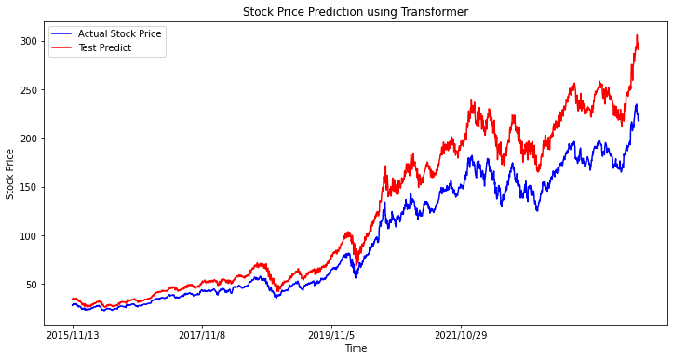
Experiments(40/43)
Predictive performance on datasets using the proposed model(AAPL)

Slide 75
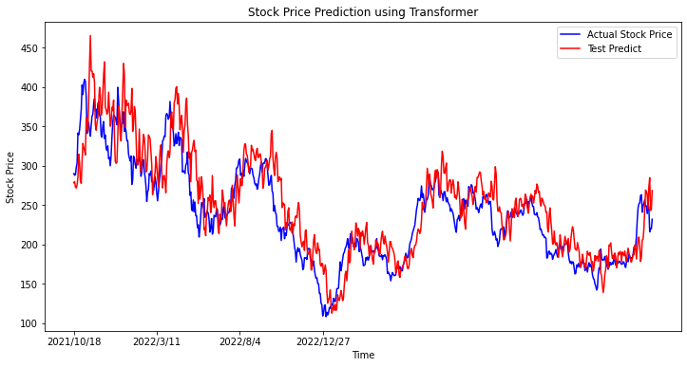
Experiments(41/43)
Predictive performance on datasets using the proposed model(TSLA)

Slide 76
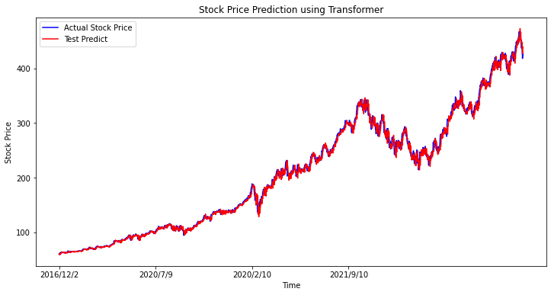
Experiments(42/43)
Predictive performance on datasets using the proposed model(MSFT)

Slide 77
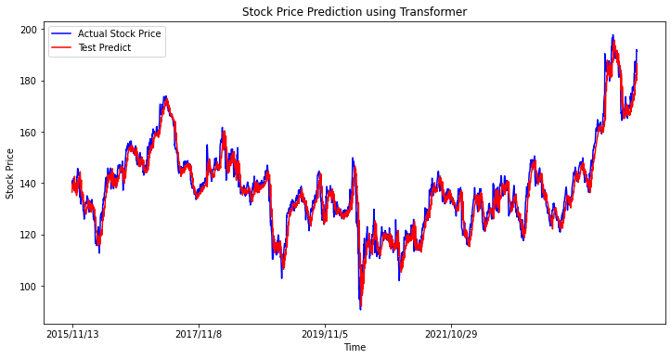
Experiments(43/43)
Predictive performance on datasets using the proposed model(IBM)

Slide 78
Conclusion

Slide 79
Conclusions(1/2)
Constructed a new dataset combining quarterly and monthly financial ratios.
Compare with other modules shows our model has better
result.
Use our model with financial ratios to predict future stock prices of new stocks.
Notes:
Finally we make a conclusion.In this paper, We built a new dataset for stock price prediction and use our model LSTM(10,50) plus attention has great performance in two datasets compare with other six methods.

Slide 80
Conclusions(2/2)
Constructed a new dataset combining quarterly and monthly financial ratios.
Compare with other modules shows our model has better
result.
Use our model with financial ratios to predict future stock prices of new stocks.
Notes:
Finally we make a conclusion.In this paper, We built a new dataset for stock price prediction and use our model LSTM(10,50) plus attention has great performance in two datasets compare with other six methods.

Slide 81
Future Work
There are relatively few studies on mixed frequency data
Improve the accuracy of our model.
Source code
https://github.com/freshpatrick/thesiscode.

Slide 82
References(1/2)
[1] A. Deep, “A multifactor analysis model for stock market prediction,” International Journal of Computer
Science and Telecommunications, vol. 14, no. 1, 2023.
[2] Zhang, Encai, et al. "Correlation analysis between stock prices and four financial indexes for some
listed companies of mainland China." 2017 10th International Congress on Image and Signal Processing,
BioMedical Engineering and Informatics (CISP-BMEI). IEEE, 2017.
[3] Doshi, Akash, et al. "Deep stock predictions." arXiv preprint arXiv:2006.04992 (2020).
[4] Kryzanowski, Lawrence, Michael Galler, and David W. Wright. "Using artificial
neural networks to pick stocks." Financial Analysts Journal 49.4 (1993): 21-27.
[5]Das, Sourav, and Bharti Nagpal. "Stock Price Prediction Using Time Embedding
and Attention Mechanism in Transformers." 2023 International Conference
on Data Science, Agents & Artificial Intelligence (ICDSAAI). IEEE, 2023.

Slide 83
References(2/2)
[6] Lin, H., et al. "Stock price prediction using generative adversarial networks." Journal of Computer
Science 17.3 (2021): 188-196.
[7] Aadhitya, A., et al. Predicting Stock Market time-series data using CNN-LSTM Neural Network
model. No. 2305.14378. 2023.
[8] Wang, Shuzhen. "A stock price prediction method based on BiLSTM and improved transformer.
" IEEE Access (2023).
[9] Zhang, Jilin, Lishi Ye, and Yongzeng Lai. "Stock price prediction using CNN-BiLSTM-Attention
model." Mathematics 11.9 (2023): 1985.

Slide 84
Thanks for listening

